Slide 1
The building blocks of a model-driven design
PRESENTED BY:
Sergey Tantsyura
Maxim Nakhod
Date: December 5, 2019

Slide 2
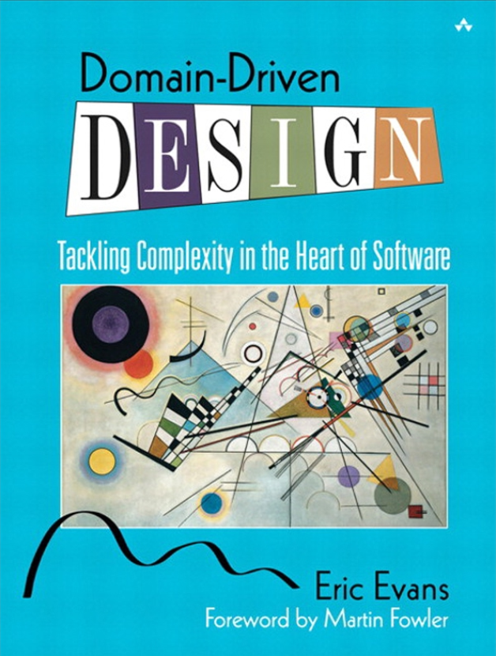

Disclaimer
Content of this training is based on Domain-Driven Design, Tackling Complexity in the Heart of Software book by Eric Evans.
This book was published in 2003 and Eric Evans introduceв Domain-Driven Design term.
This book is the primary source of knowledge on Domain-Driven Design topic, though it may be a bit hard to read.

Slide 3

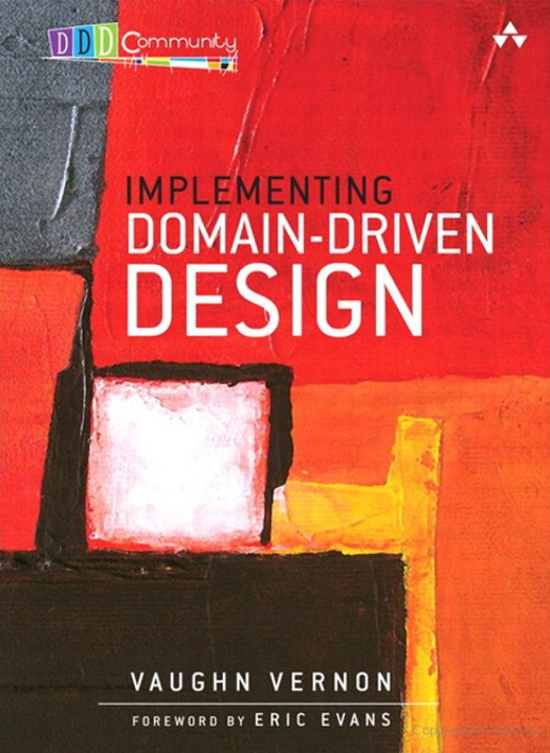
Other books on DDD topic
Domain-Driven Design Distilled by Vaughn Vernon | Implementing Domain-Driven Design by Vaughn Vernon

Slide 4

Presentation and examples on GitHub
This presentation and all examples can be found on GitHub:
https://github.com/tantsyurasergey/DDDTraining

Slide 5
Agenda
01
02
03
04
05
06
07
Domain Modeling
Crunching Knowledge
Communication and the Use of Language
Binding Model and Implementation
Isolating the Domain
A Model Expressed in Software
The Life Cycle of a Domain Object
Notes:
STA: 01, 03, 05, 07
MN: 02, 04, 06

Slide 6
Domain Modeling

Slide 7
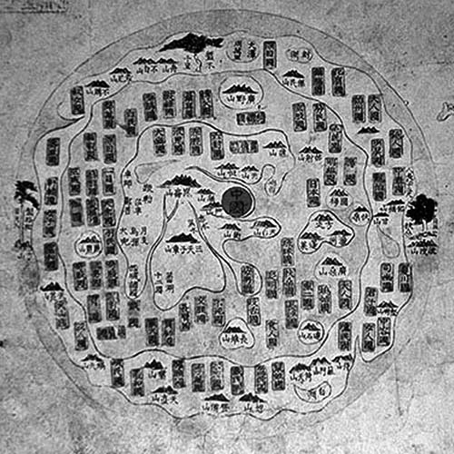
Maps and models
This eighteenth-century Chinese map represents the whole world. This was a model of the world appropriate to that society, which had intentionally turned inward.
Maps are models, and every model represents some aspect of reality or an idea that is of interest. A model is a simplification. It is an interpretation of reality that abstracts the aspects relevant to solving the problem at hand and ignores extraneous detail.

Slide 8
What is domain?
Every software program relates to some activity or interest of its user. That subject area to which the user applies the program is the domain of the software.
Some domains involve the physical world: The domain of an airline-booking program involves real people getting on real aircraft. Some domains are intangible: The domain of an accounting program is money and finance.
Software domains usually have little to do with computers, though there are exceptions: The domain of a source-code control system is software development itself.

Slide 9
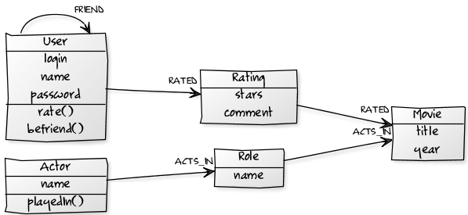
What is domain model?
A domain model is not a particular diagram; it is the idea that the diagram is intended to convey. It is not just the knowledge in a domain expert’s head; it is a rigorously organized and selective abstraction of that knowledge.
A diagram can represent and communicate a model, as can carefully written code, as can an English sentence.

Slide 10

Domain modeling
Domain modeling is not a matter of making as “realistic” a model as possible. Even in a domain of tangible real-world things, our model is an artificial creation.
It is more like moviemaking, loosely representing reality to a particular purpose. Just as a moviemaker selects aspects of experience and presents them in an idiosyncratic way to tell a story or make a point, a domain modeler chooses a particular model for its utility.

Slide 11
The Utility of a Model in Domain-Driven Design
In DDD, three basic uses determine the choice of a model:
The model and the heart of the design shape each other.
Link between the model and the implementation makes the model relevant and ensures that the analysis that went into it applies to the final product, a running program.
The model is the backbone of a language used by all team members.
Because of the binding of model and implementation, developers can talk about the program in this language. They can communicate with domain experts without translation.
The model is distilled knowledge.
The model is the team’s agreed-upon way of structuring domain knowledge and distinguishing the elements of most interest. A model captures how we choose to think about the domain as we select terms, break down concepts, and relate them.

Slide 12
Crunching Knowledge

Slide 13
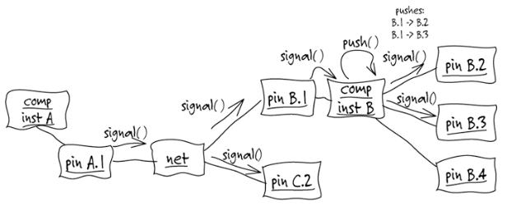
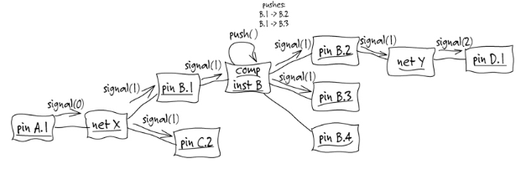
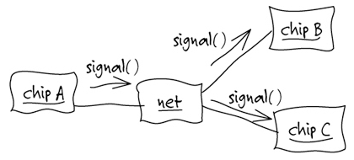
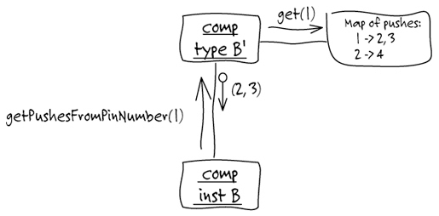
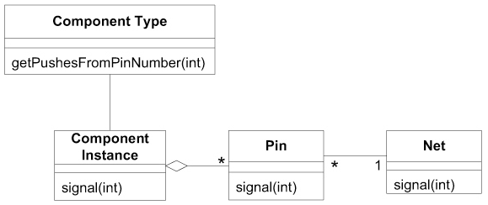
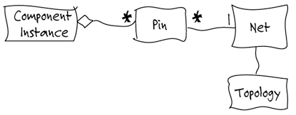
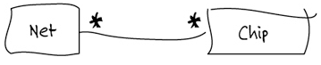
Learning from experts
Example: designing a specialized software tool for printed-circuit board (PCB) design.

Slide 14

Ingredients of Effective Modeling
Binding the model and the implementation.
Cultivating a language based on the model
Developing a knowledge-rich model.
Distilling the model.
Brainstorming and experimenting.

Slide 15

Knowledge Crunching
Effective domain modelers are knowledge crunchers. They take a torrent of information and probe for the relevant trickle. They try one organizing idea after another, searching for the simple view that makes sense of the mass.
Many models are tried and rejected or transformed. Success comes in an emerging set of abstract concepts that makes sense of all the detail.
Knowledge crunching is not a solitary activity. A team of developers and domain experts collaborate, typically led by developers.

Slide 16
Communication and the Use of Language

Slide 17

A common problem in communication
A project faces serious problems when its language is fractured. Domain experts use their jargon while technical team members have their own language tuned for discussing the domain in terms of design.
The terminology of day-to-day discussions is disconnected from the terminology embedded in the code.
Translation blunts communication and makes knowledge crunching anemic.
Yet none of these dialects can be a common language because none serves all needs.

Slide 18
Ubiquitous Language as a solution
Use the model as the backbone of a language. Commit the team to exercising that language relentlessly in all communication within the team and in the code.
Iron out difficulties by experimenting with alternative expressions, which reflect alternative models. Then refactor the code, renaming classes, methods, and modules to conform to the new model.
Recognize that a change in the UBIQUITOUS LANGUAGE is a change to the model.
Domain experts should object to terms or structures that are awkward or inadequate to convey domain understanding; developers should watch for ambiguity or inconsistency that will trip up design.

Slide 19
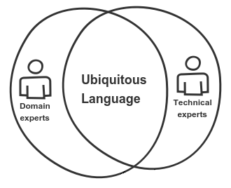
One Team, One Language
Technical people often feel the need to “shield” the business experts from the domain model.
Of course there are technical components of the design that may not concern the domain experts, but the core of the model had better interest them. Too abstract? Then how do you know the abstractions are sound? Do you understand the domain as deeply as they do?
If sophisticated domain experts don’t understand the model, there is something wrong with the model.

Slide 20
Binding Model and Implementation

Slide 21
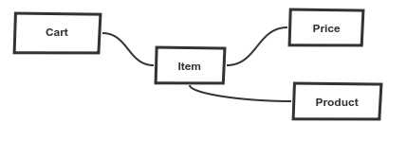
Mismatch between Design and Domain Model
If the design, or some central part of it, does not map to the domain model, that model is of little value, and the correctness of the software is suspect.
At the same time, complex mappings between models and design functions are difficult to understand and, in practice, impossible to maintain as the design changes. A deadly divide opens between analysis and design so that insight gained in each of those activities does not feed into the other.

Slide 22
How to Bind Model and Implementation?
Design a portion of the software system to reflect the domain model in a very literal way, so that mapping is obvious.
Revisit the model and modify it to be implemented more naturally in software, even as you seek to make it reflect deeper insight into the domain.
Demand a single model that serves both purposes well, in addition to supporting a robust UBIQUITOUS LANGUAGE.
Draw from the model the terminology used in the design and the basic assignment of responsibilities. The code becomes an expression of the model, so a change to the code may be a change to the model. Its effect must ripple through the rest of the project’s activities accordingly.

Slide 23
Pitfall: Overseparation of Responsibility
All teams have specialized roles for members, but overseparation of responsibility for analysis, modeling, design, and programming interferes with Model-Driven Design.
If the people who write the code do not feel responsible for the model, or don’t understand how to make the model work for an application, then the model has nothing to do with the software.
If developers don’t realize that changing code changes the model, then their refactoring will weaken the model rather than strengthen it.
The knowledge and skills of experienced designers won’t be transferred to other developers if the division of labor prevents the kind of collaboration that conveys subtleties of coding a Model-Driven Design.

Slide 24
Recommendations
Any technical person contributing to the model must spend some time touching the code, whatever primary role he or she plays on the project.
Anyone responsible for changing code must learn to express a model through the code.
Every developer must be involved in some level of discussion about the model and have contact with domain experts.
Those who contribute in different ways must consciously engage those who touch the code in a dynamic exchange of model ideas through the UBIQUITOUS LANGUAGE.

Slide 25
Isolating the Domain

Slide 26
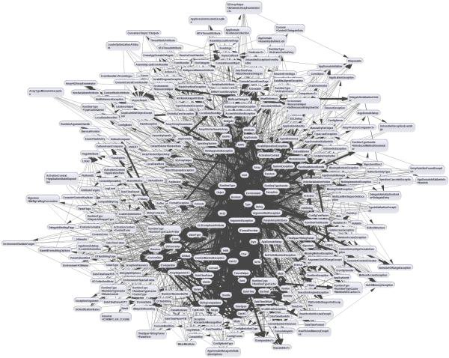
Mixing domain-related code and other code
In an object-oriented program, UI, database, and other support code often gets written directly into the business objects. Additional business logic is embedded in the behavior of UI widgets and database scripts. This happens because it is the easiest way to make things work, in the short run.
When the domain-related code is diffused through such a large amount of other code, it becomes extremely difficult to see and to reason about.

Slide 27
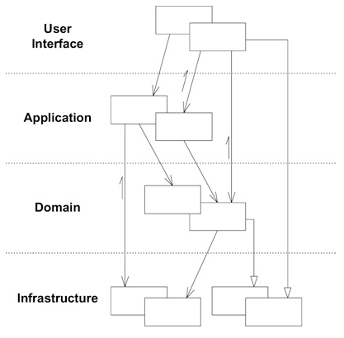
Layered Architecture
Partition a complex program into layers. Develop a design within each layer that is cohesive and that depends only on the layers below.
Concentrate all the code related to the domain model in one layer and isolate it from the user interface, application, and infrastructure code. The domain objects, free of the responsibility of displaying themselves, storing themselves, and so forth, can be focused on expressing the domain model.

Slide 28
Layered Architecture
Conceptual Layers Used in Most Successful Architectures
Layer | Description
User Interface (or Presentation Layer) | Responsible for showing information to the user and interpreting the user’s commands. The external actor might sometimes be another computer system rather than a human user.
Application Layer | Defines the jobs the software is supposed to do and directs the expressive domain objects to work out problems. The tasks this layer is responsible for are meaningful to the business or necessary for interaction with the application layers of other systems. This layer is kept thin. It does not contain business rules or knowledge, but only coordinates tasks and delegates work to collaborations of domain objects in the next layer down.
Domain Layer (or Model Layer) | Responsible for representing concepts of the business, information about the business situation, and business rules. State that reflects the business situation is controlled and used here, even though the technical details of storing it are delegated to the infrastructure. This layer is the heart of business software.
Infrastructure Layer | Provides generic technical capabilities that support the higher layers: message sending for the application, persistence for the domain, and so on.

Slide 29
A Model Expressed in Software

Slide 30
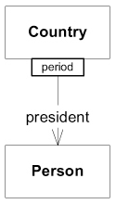
Associations
For every traversable association in the model, there is a mechanism in the software with the same properties.
There are at least three ways of making associations more tractable.
Imposing a traversal direction
Adding a qualifier, effectively reducing multiplicity
Eliminating nonessential associations

Slide 31

Entities (Reference Objects)
Some objects are not defined primarily by their attributes. They represent a thread of identity that runs through time and often across distinct representations.
Sometimes such an object must be matched with another object even though attributes differ. An object must be distinguished from other objects even though they might have the same attributes.
Mistaken identity can lead to data corruption.

Slide 32
Entities - Recommendations
When an object is distinguished by its identity, rather than its attributes, make this primary to its definition in the model. Keep the class definition simple and focused on life cycle continuity and identity.
Define a means of distinguishing each object regardless of its form or history. Be alert to requirements that call for matching objects by attributes.
Define an operation that is guaranteed to produce a unique result for each object, possibly by attaching a symbol that is guaranteed unique. This means of identification may come from the outside, or it may be an arbitrary identifier created by and for the system, but it must correspond to the identity distinctions in the model. The model must define what it means to be the same thing.

Slide 33
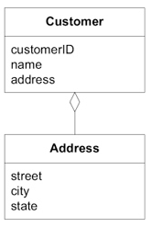
Value Objects
When you care only about the attributes of an element of the model, classify it as a VALUE OBJECT. Make it express the meaning of the attributes it conveys and give it related functionality. Treat the VALUE OBJECT as immutable. Don’t give it any identity and avoid the design complexities necessary to maintain ENTITIES.

Slide 34

Services
Some concepts from the domain aren’t natural to model as objects.
When a significant process or transformation in the domain is not a natural responsibility of an ENTITY or VALUE OBJECT, add an operation to the model as a standalone interface declared as a SERVICE. Define the interface in terms of the language of the model and make sure the operation name is part of the UBIQUITOUS LANGUAGE.

Slide 35

Characteristics of a Service
A good SERVICE has three characteristics.
The operation relates to a domain concept that is not a natural part of an ENTITY or VALUE OBJECT.
The interface is defined in terms of other elements of the domain model.
The operation is stateless.

Slide 36
Partitioning Services into Layers
Partitioning Services into Layers
Layer | Responsibility
Application | Funds Transfer App Service Digests input (such as an XML request). Sends message to domain service for fulfillment. Listens for confirmation. Decides to send notification using infrastructure service.
Domain | Funds Transfer Domain Service Interacts with necessary Account and Ledger objects, making appropriate debits and credits. Supplies confirmation of result (transfer allowed or not, and so on).
Infrastructure | Send Notification Service Sends e-mails, letters, and other communications as directed by the application.

Slide 37

Modules (Packages)
Everyone uses MODULES, but few treat them as a full-fledged part of the model.
It is a truism that there should be low coupling between MODULES and high cohesion within them.
Yet it isn’t just code being divided into MODULES, but concepts. There is a limit to how many things a person can think about at once (hence low coupling). Incoherent fragments of ideas are as hard to understand as an undifferentiated soup of ideas (hence high cohesion).

Slide 38
Modules - Recommendations
Choose MODULES that tell the story of the system and contain a cohesive set of concepts. This often yields low coupling between MODULES.
Seek low coupling in the sense of concepts that can be understood and reasoned about independently of each other. Refine the model until it partitions according to high-level domain concepts and the corresponding code is decoupled as well.
Use packaging to separate the domain layer from other code.
Give the MODULES names that become part of the UBIQUITOUS LANGUAGE. MODULES and their names should reflect insight into the domain.

Slide 39
The Life Cycle of a Domain Object

Slide 40
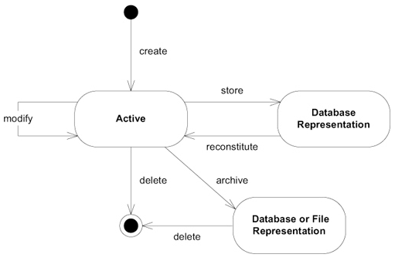
The Life Cycle of a Domain Object
Every object has a life cycle. An object is born, it likely goes through various states, and it eventually dies—being either archived or deleted.

Slide 41
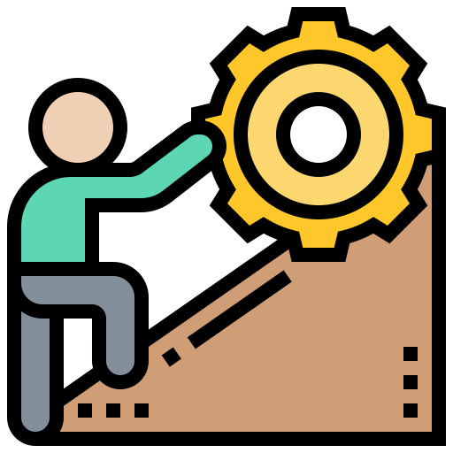
Life Cycle Management Challenges
Many objects are simple, transient objects, created with an easy call to their constructor, used in some computation, and then abandoned to the garbage collector.
But other objects have longer lives, not all of which are spent in active memory. They have complex interdependencies with other objects. They go through changes of state to which invariants apply.

Slide 42
Life Cycle Management Challenges
Managing complex objects presents challenges that fall into two categories:
Maintaining integrity throughout the life cycle.
Preventing the model from getting swamped by the complexity of managing the life cycle.
The following patterns address these challenges:
Aggregates
Factories
Repositories

Slide 43

Aggregates
An AGGREGATE is a cluster of associated objects that we treat as a unit for the purpose of data changes.
Each AGGREGATE has a root and a boundary. The boundary defines what is inside the AGGREGATE.
The root is a single, specific ENTITY contained in the AGGREGATE.
This pattern is crucial to maintaining integrity in all phases of the life cycle.

Slide 44
Rules Applied to Aggregates
The root ENTITY has global identity and is ultimately responsible for checking invariants.
Root ENTITIES have global identity. ENTITIES inside the boundary have local identity, unique only within the AGGREGATE.
Nothing outside the AGGREGATE boundary can hold a reference to anything inside, except to the root ENTITY. The root ENTITY can hand references to the internal ENTITIES to other objects, but those objects can use them only transiently, and they may not hold on to the reference. The root may hand a copy of a VALUE OBJECT to another object, and it doesn’t matter what happens to it, because it’s just a VALUE and no longer will have any association with the AGGREGATE.

Slide 45
Rules Applied to Aggregates
Only AGGREGATE roots can be obtained directly with database queries. All other objects must be found by traversal of associations.
Objects within the AGGREGATE can hold references to other AGGREGATE roots.
A delete operation must remove everything within the AGGREGATE boundary at once.
When a change to any object within the AGGREGATE boundary is committed, all invariants of the whole AGGREGATE must be satisfied.

Slide 46
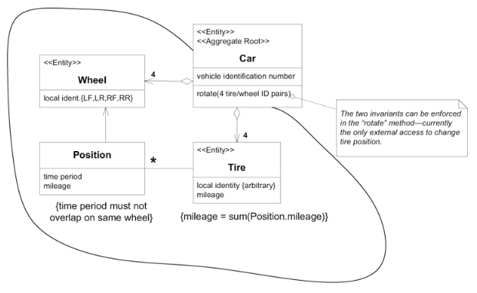
Example of an Aggregate

Slide 47

Factories
When creation of an object, or an entire AGGREGATE, becomes complicated or reveals too much of the internal structure, FACTORIES provide encapsulation.
Shift the responsibility for creating instances of complex objects and AGGREGATES to a separate object, which may itself have no responsibility in the domain model but is still part of the domain design. Provide an interface that encapsulates all complex assembly. Create entire AGGREGATES as a piece, enforcing their invariants.

Slide 48
Requirements for a Factory
Each creation method is atomic and enforces all invariants of the created object or AGGREGATE. A FACTORY should only be able to produce an object in a consistent state. For an ENTITY, this means the creation of the entire AGGREGATE, with all invariants satisfied, but probably with optional elements still to be added. For an immutable VALUE OBJECT, this means that all attributes are initialized to their correct final state. If the interface makes it possible to request an object that can’t be created correctly, then an exception should be raised.
The FACTORY should be abstracted to the type desired, rather than the concrete class(es) created.

Slide 49
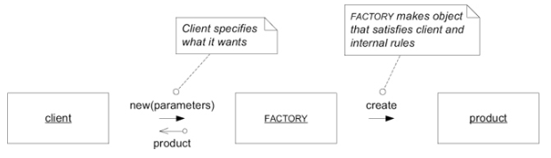
Basic Interactions with a Factory

Slide 50
Choosing Factories and Their Sites
If you need to add elements inside a preexisting AGGREGATE, you might create a FACTORY METHOD on the root of the AGGREGATE.
Place a FACTORY METHOD on an object that is closely involved in spawning another object, although it doesn’t own the product once it is created.
When there doesn’t seem to be a natural host, we must create a dedicated FACTORY object or SERVICE. A standalone FACTORY usually produces an entire AGGREGATE, handing out a reference to the root, and ensuring that the product AGGREGATE’S invariants are enforced.

Slide 51

Entity Factories vs Value Object Factories
VALUE OBJECTS are immutable; the product comes out complete in its final form. ENTITY FACTORIES tend to take just the essential attributes required to make a valid AGGREGATE. Details can be added later if they are not required by an invariant.
There are the issues involved in assigning identity to an ENTITY — irrelevant to a VALUE OBJECT. An identifier can either be assigned automatically by the program or supplied from the outside, typically by the user.
<<Entity>>
VS
<<Value Object>>

Slide 52
Need for Repositories
Associations allow us to find an object based on its relationship to another. But we must have a starting point for a traversal to an ENTITY or VALUE in the middle of its life cycle.
Free database queries can actually breach the encapsulation of domain objects and AGGREGATES.
Exposure of technical infrastructure and database access mechanisms complicates the client and obscures the MODEL-DRIVEN DESIGN.

Slide 53

Repositories
A REPOSITORY represents all objects of a certain type as a conceptual set (usually emulated).
It acts like a collection, except with more elaborate querying capability.
Objects of the appropriate type are added and removed, and the machinery behind the REPOSITORY inserts them or deletes them from the database.

Slide 54
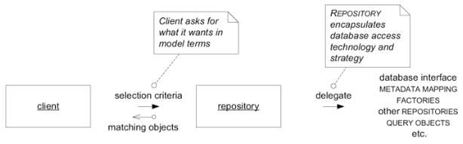
Querying the repository
The easiest REPOSITORY to build has hard-coded queries with specific parameters.
On projects with a lot of querying, a REPOSITORY framework can be built that allows more flexible queries. One particularly apt approach to generalizing REPOSITORIES through a framework is to use SPECIFICATION-based queries. A SPECIFICATION allows a client to describe what it wants without concern for how it will be obtained.

Slide 55
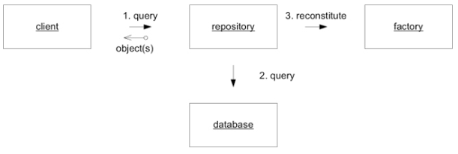
The Relationship with Factories
Because the REPOSITORY is creating objects based on data, many people consider the REPOSITORY to be a FACTORY. But the reconstitution of a stored object is not the creation of a new conceptual object.
In domain-driven view of the design, FACTORIES and REPOSITORIES have distinct responsibilities. The FACTORY makes new objects; the REPOSITORY finds old objects.

Slide 56
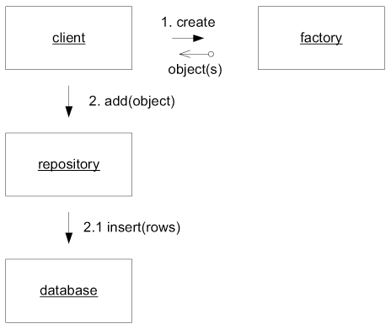
The Relationship with Factories
This clear separation also helps by unloading all responsibility for persistence from the FACTORIES . A FACTORY’S job is to instantiate a potentially complex object from data. If the product is a new object, the client will know this and can add it to the REPOSITORY, which will encapsulate the storage of the object in the database.

Slide 57
Summary

Slide 58
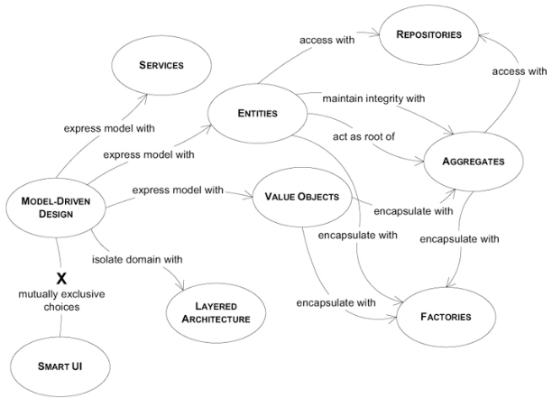
A navigation map of the language of MODEL-DRIVEN DESIGN

Slide 59
Q&A

